Slide 1
Let’s Build A Simple Web Server From Scratch
Kevin Griffin
@1kevgriff – linkedin.com/in/1kevgriff

Slide 2
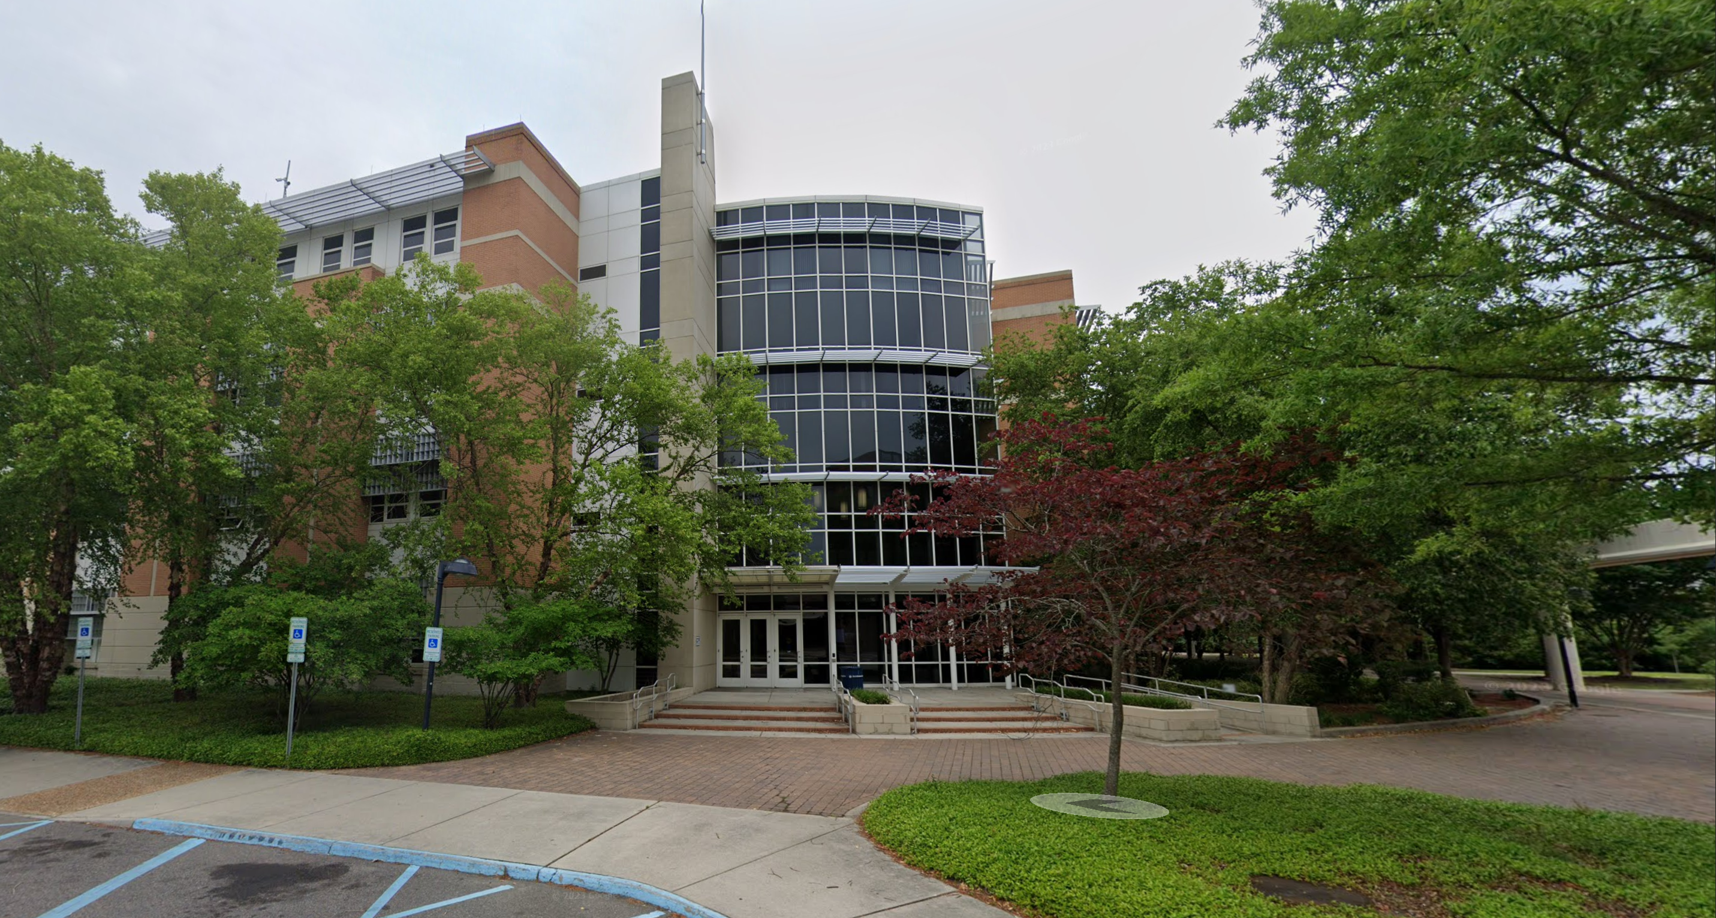

Slide 3
The CS 431/531 Web Server Design course focuses on complete understanding of the Hypertext Transfer Protocol (HTTP) and implementation of a web server (not a web application). The course is programming intensive, prerequisites include the understanding of network (socket) programming. Students in this course decide their own implementation language within the Unix/Linux environment; the lectures are about HTTP and not about any particular programming language.
CS 431/531

Slide 4

Hi, I’m Kevin

Slide 5
Kevin Griffin 14-time Microsoft MVP ASP.NET Core, Azure, and Web consultwithgriff.com twitter.com/@1kevgriff bbiz.io/@1kevgriff

Slide 6
Client
Server

Slide 7
Client
Server
Request
Response

Slide 8
Client
Server
Request
Response
A client sends an HTTP request to a server in the form of a request message, beginning with a request-line that includes a method, URI, and protocol version (Section 3.1.1), followed by header fields containing request modifiers, client information, and representation metadata (Section 3.2), an empty line to indicate the end of the header section, and finally a message body containing the payload body (if any, Section 3.3).
RFC-7230

Slide 9
Client
Server
Request
Response
A server responds to a client's request by sending one or more HTTP response messages, each beginning with a status line that includes the protocol version, a success or error code, and textual reason phrase (Section 3.1.2), possibly followed by header fields containing server information, resource metadata, and representation metadata (Section 3.2), an empty line to indicate the end of the header section, and finally a message body containing the payload body (if any, Section 3.3).
RFC-7230

Slide 10
RFCs
Request for Comments
Drafts by working groups of computer scientists and practicioners on agreed ways things should work
RFC 7230: (HTTP/1.1): Message Syntax and Routing
RFC 7231: (HTTP/1.1): Semantics and Content)

Slide 11
RFC 9114
What about
HTTP/2 or HTTP/3?
RFC 7540

Slide 12
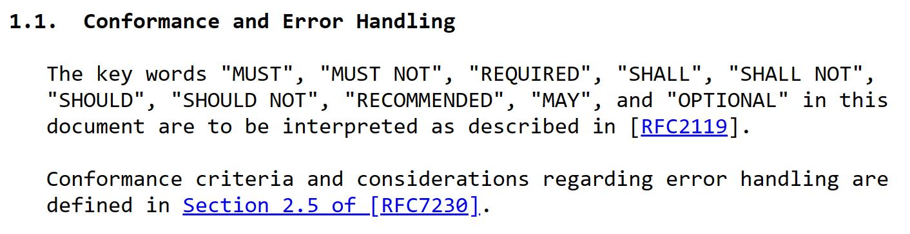
RFC Terminology

Slide 13
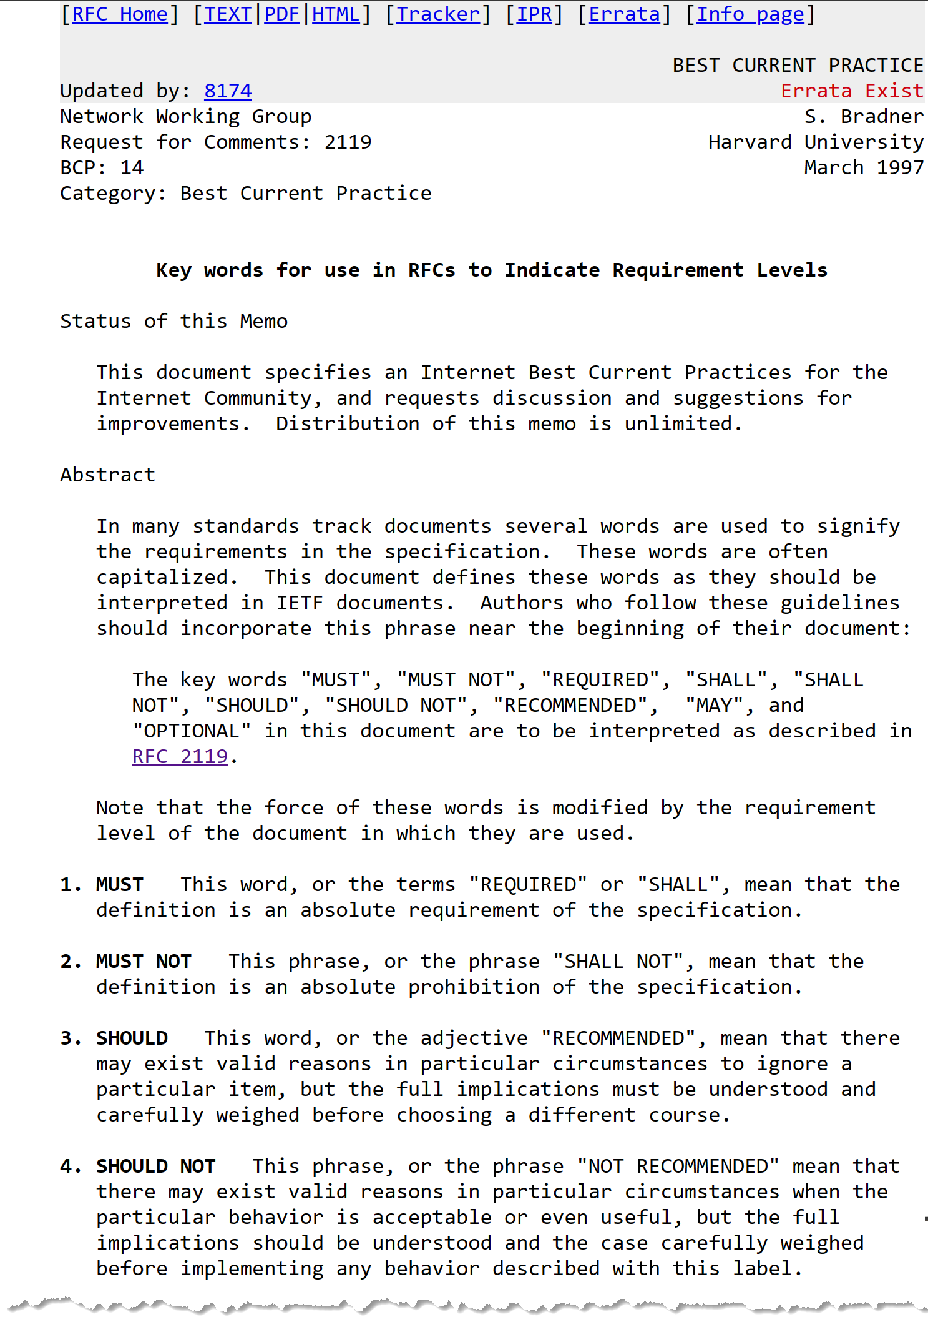

Slide 14
Lesson Learned: Not all existing implementations obey the RFC

Slide 15
Client
Server
SOCKET
SOCKET
0100011101000101010101000010000000101111001000000100100001010100010101000101000000101111001100010010111000110001
GET / HTTP/1.1

Slide 16
Client
Server
SOCKET
SOCKET
(todo: response message)

Slide 17
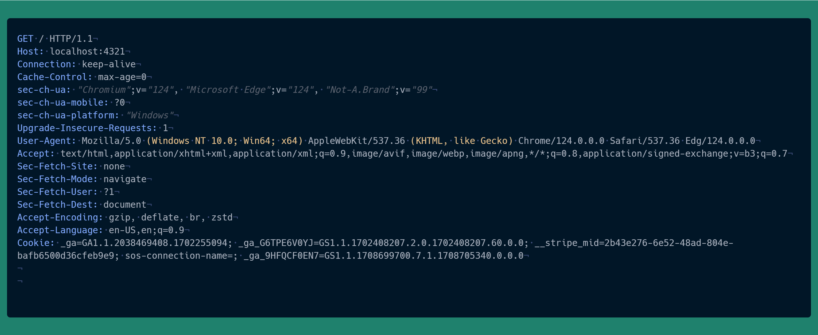

Slide 18
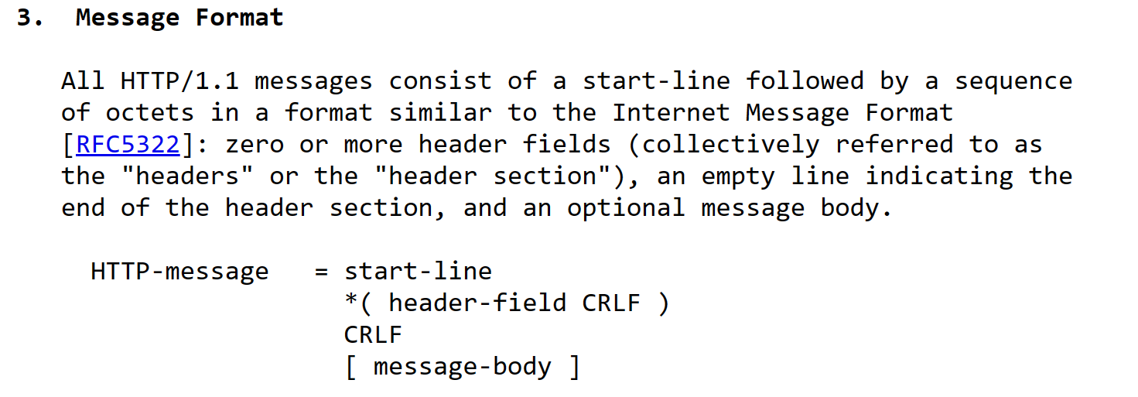


Slide 19
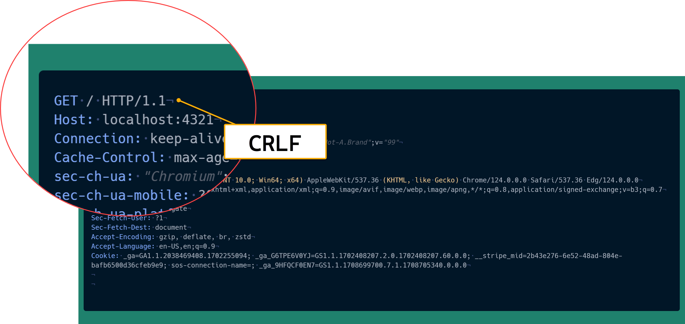

Slide 20


Slide 21
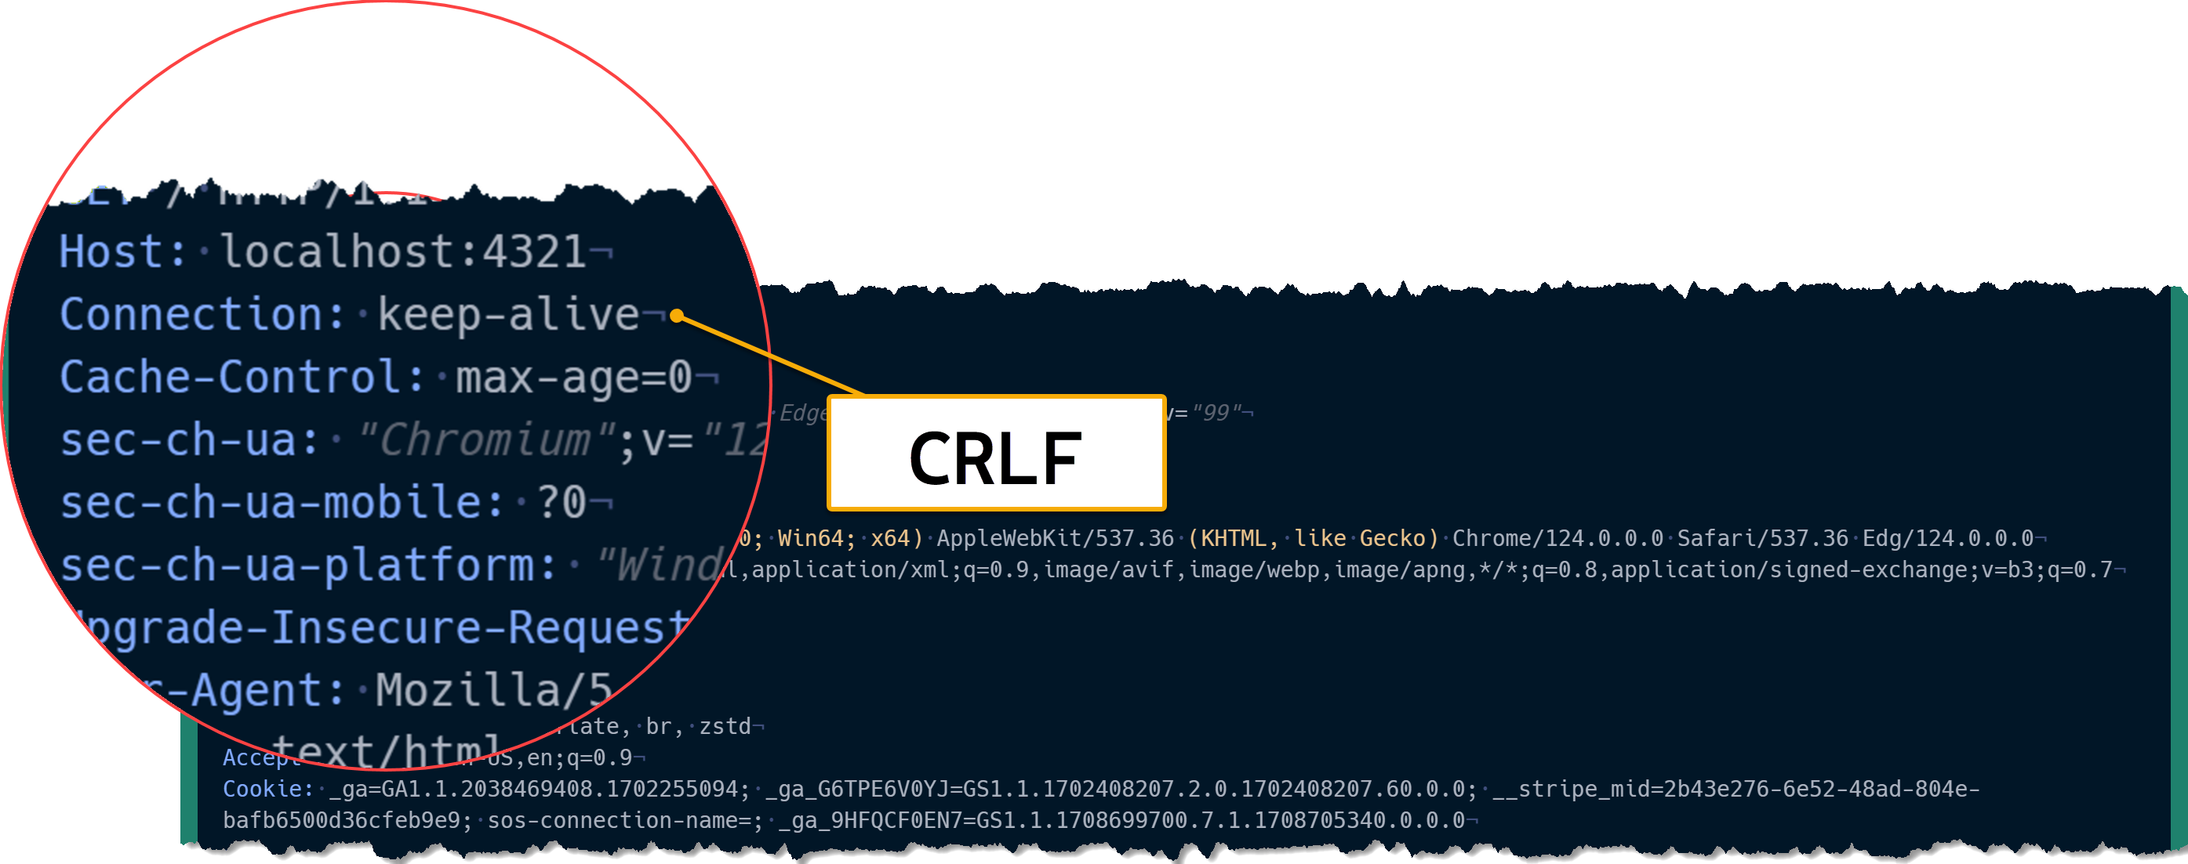

Slide 23
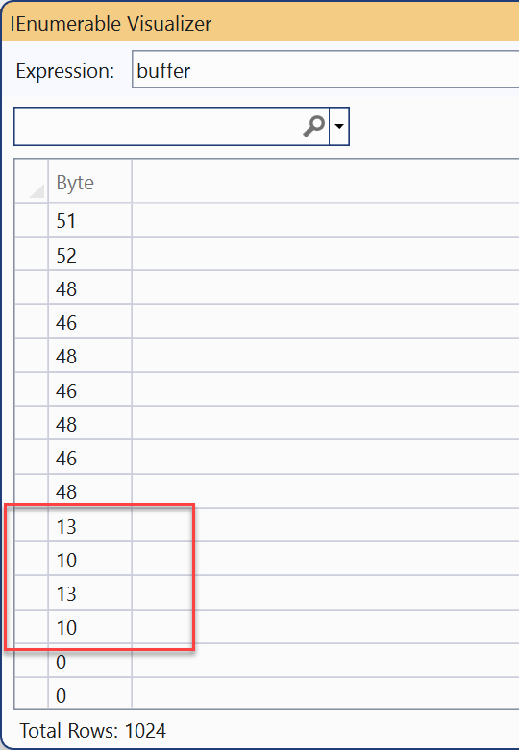

Slide 24
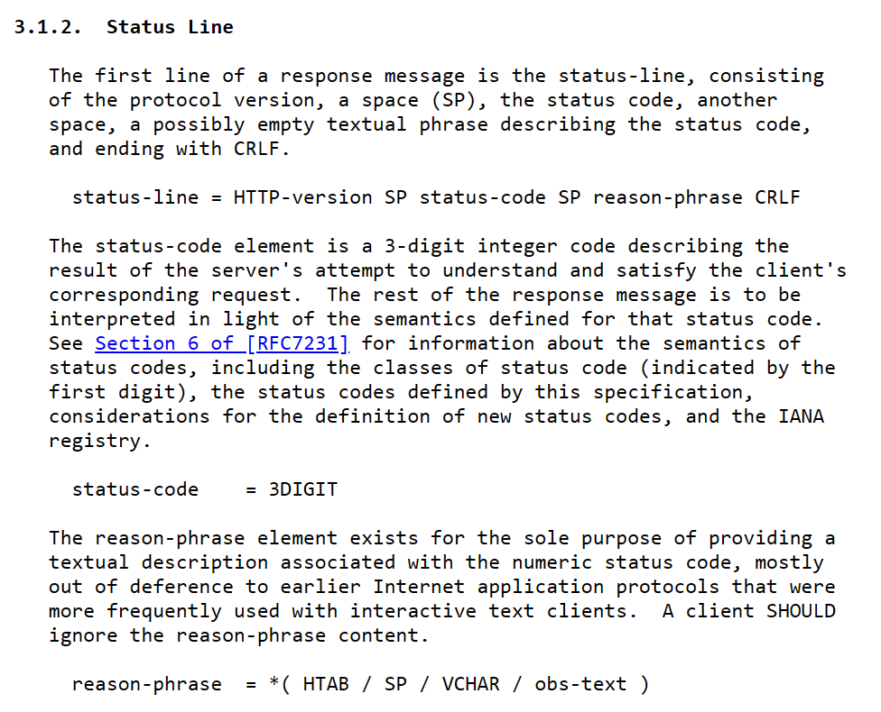

Slide 25
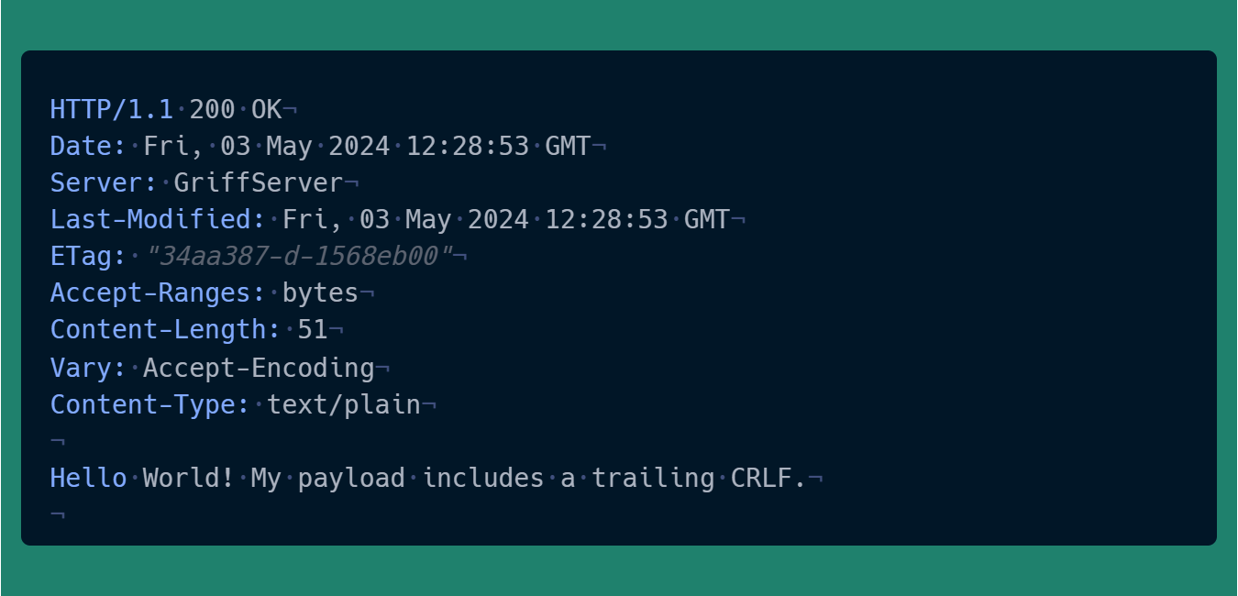

Slide 26
What headers are required?

Slide 27
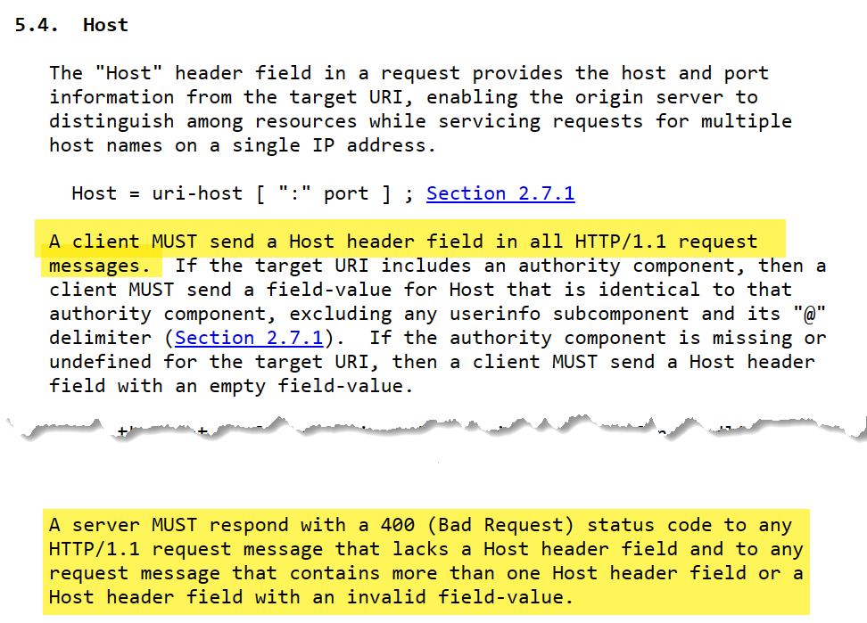

Slide 28
Demo: Simple HTTP with C#

Slide 29
Accept-Encoding

Slide 30
Caching

Slide 31
Thanks!

